Slide 1
Banking Customer Behavior and Financial Performance Analysis
Capstone Project using Python, SQL & Power BI

Slide 2
Acknowledgement
I would like to express my sincere gratitude to my mentors, instructors, and learning platforms for their continuous guidance and support throughout this project. This capstone project is a result of practical learning and hands-on implementation using Python (Pandas, NumPy), SQL, and Power BI. I also thank the data analytics community and online resources that helped me understand data cleaning, SQL joins, KPI building, and dashboard creation. This project reflects my ability to convert raw data into meaningful insights using industry-relevant tools.

Slide 3
Project Objective
Understand customer behavior and Analyze Accounts
Analyze transactions
Monitor loan performance and Analyze Complaints
Identify high-value customers
Build end-to-end data analytics pipeline

Slide 4
Project Workflow
Step 1: Data Cleaning using Python (Pandas, NumPy)
Step 2: Data Import & Analysis in SQL (KPI, Joins, Group by )
Step 3: Data Visualization in Power BI (Data Cleaning , Calculate Measures And Conditional Column , Dashboard Creation)

Slide 5
Step 1: Data Cleaning (Python)
In the first step, I used Python libraries Pandas and NumPy to clean the raw dataset.
• Handled missing values using fillna()
• Removed duplicates using drop_duplicates()
• Converted data types (date, numeric)
• Standardized column formats
• Ensured data consistency
This step ensures high-quality data before moving to SQL.

Slide 6
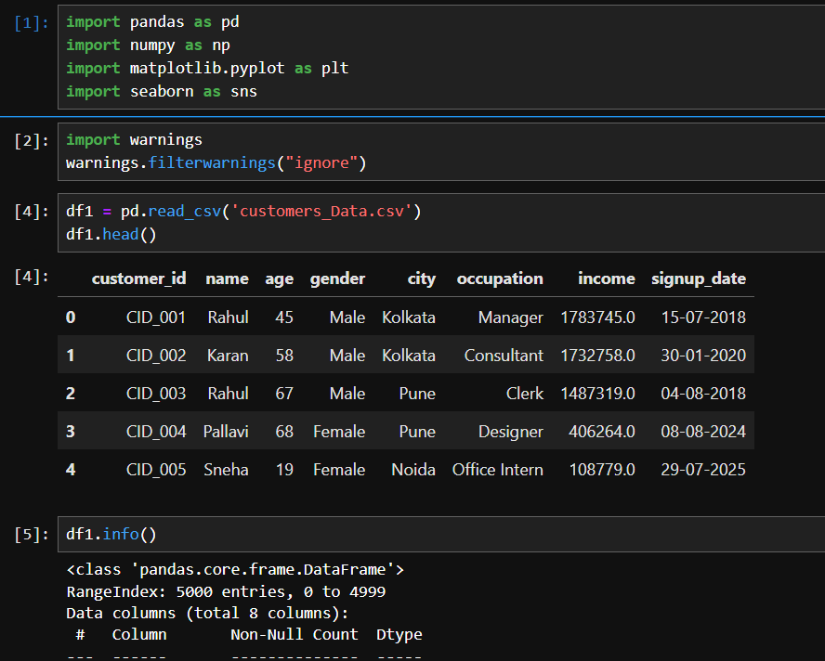
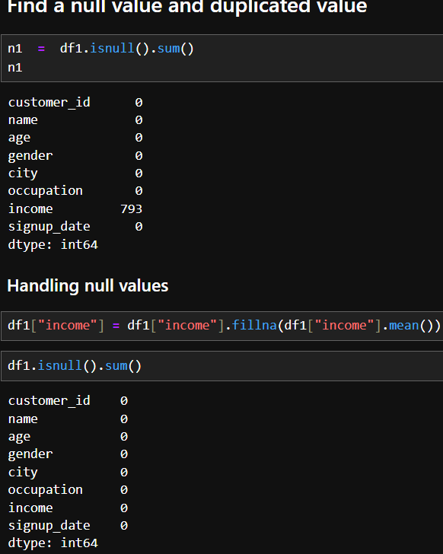
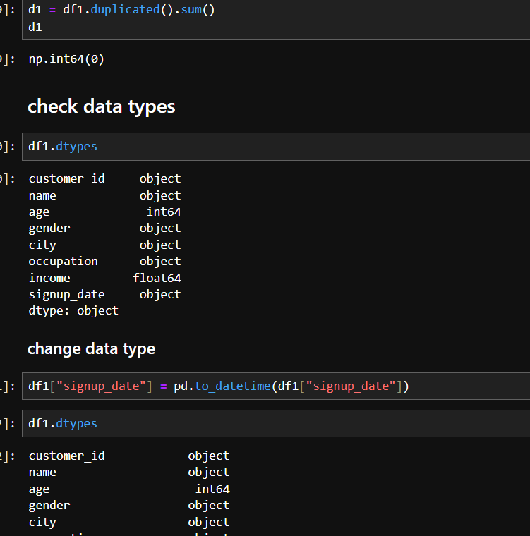
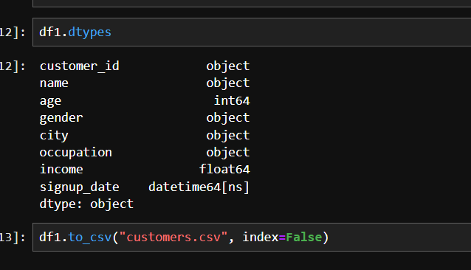
Python Data Cleaning Screenshot
Insert Screenshot Here

Slide 7
Step 2: SQL Analysis & KPI
After cleaning, the data was imported into SQL for analysis.
• Created tables - Customers, Accounts, Transaction, Loan, Loan_Payment, Complaints
• Used JOIN to combine multiple tables
• Applied GROUP BY for aggregation
• Created KPIs like total transactions, loan amount, complaints count etc.
SQL helped in building a strong analytical layer.

Slide 8
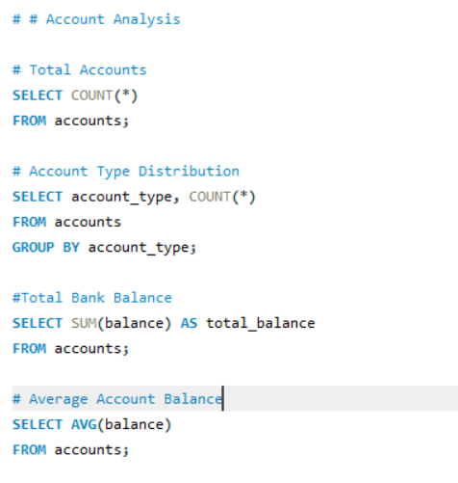
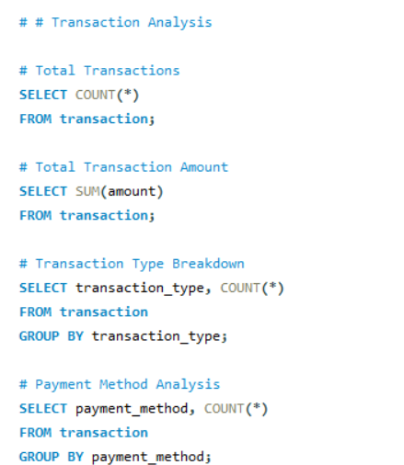
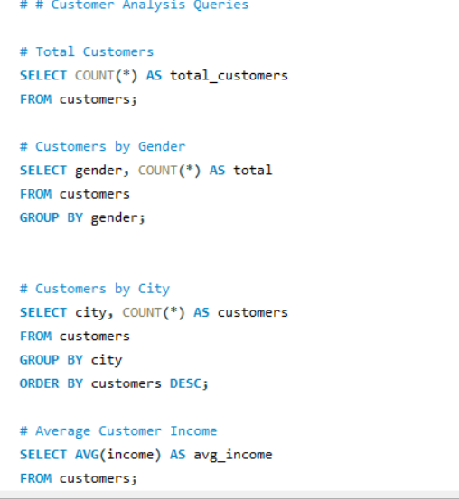
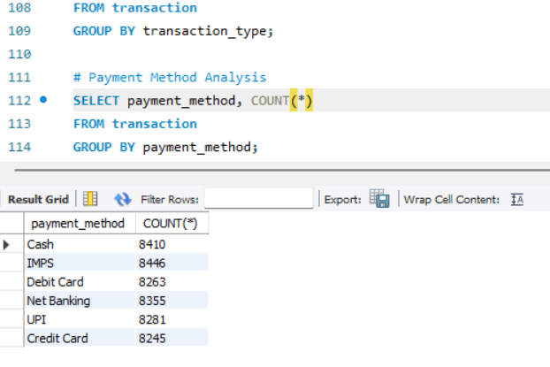
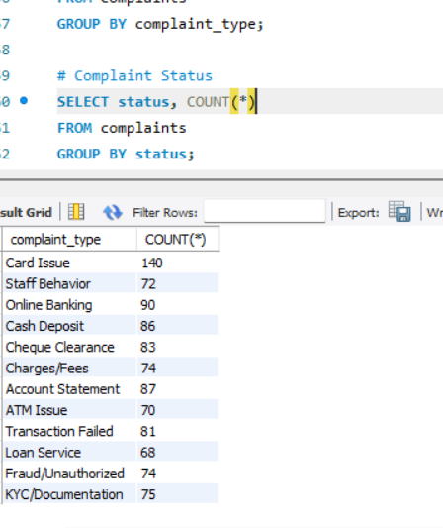
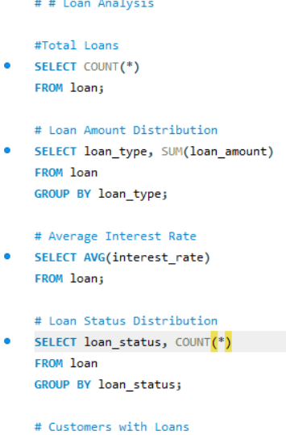

Slide 9
Step 3: Power BI Dashboard
Data was then loaded into Power BI for visualization.
• Performed additional data cleaning in Power Query
• Created relationships (joins) between tables
• Used Merge & Append operations
• Created calculated columns and DAX measures
• Built KPIs and interactive charts
This step transforms data into business insights.

Slide 10
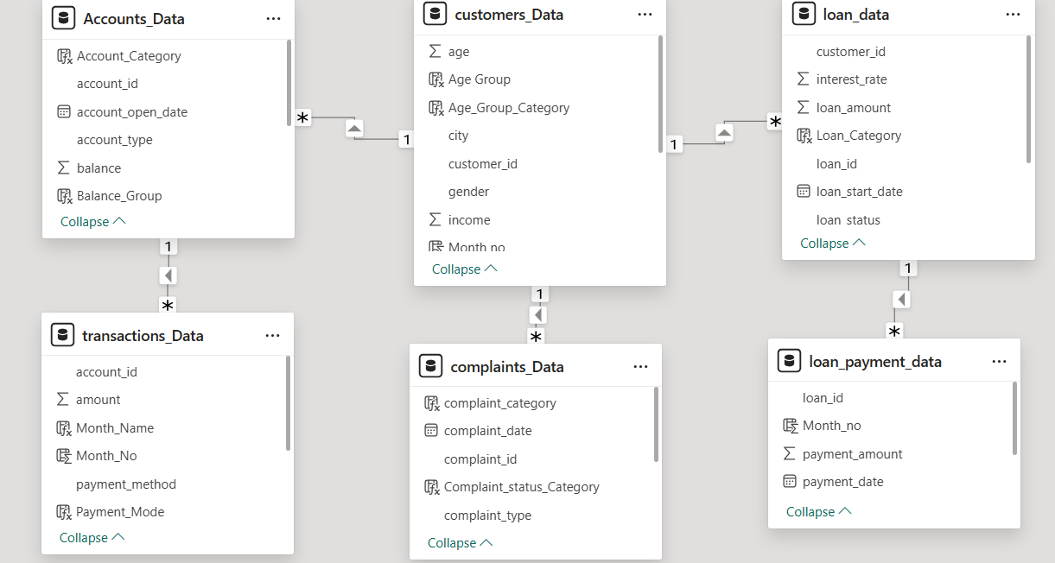
Power BI Data Model
Insert Screenshot Here

Slide 11
Power BI Dashboards
Developed 5 dashboards:
1. Customer Overview
2. Accounts Analysis
3. Transaction Analysis
4. Loan & Loan Payment Analysis
5. Complaints Analysis

Slide 12
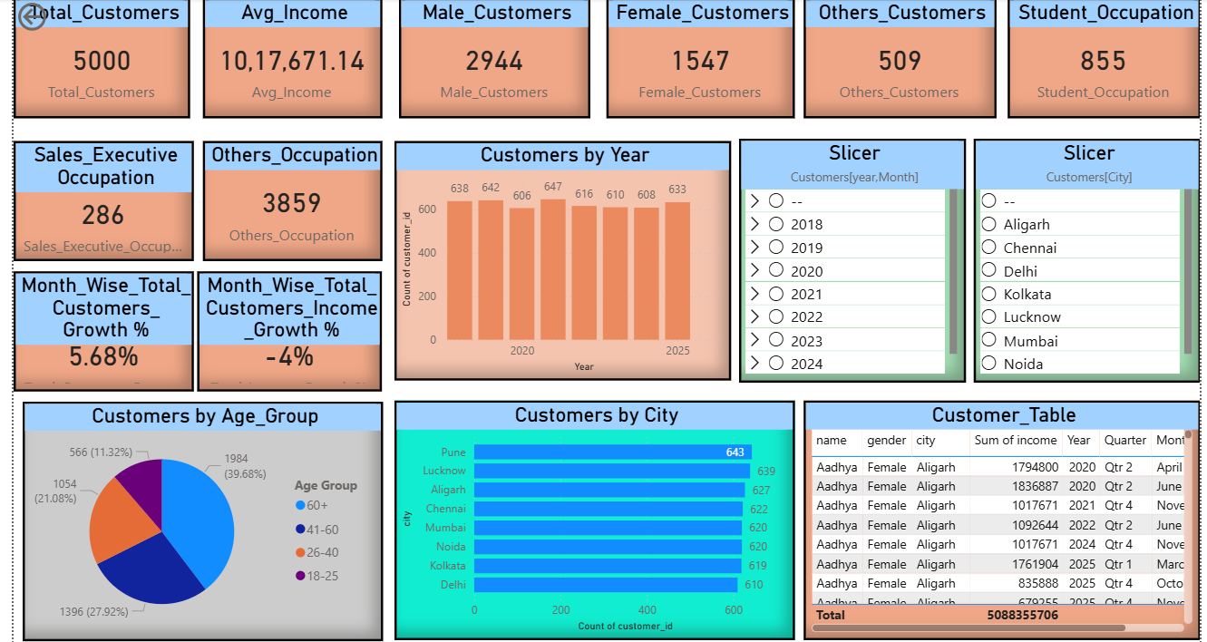
Customer Overview Dashboard
Insert Screenshot Here

Slide 13
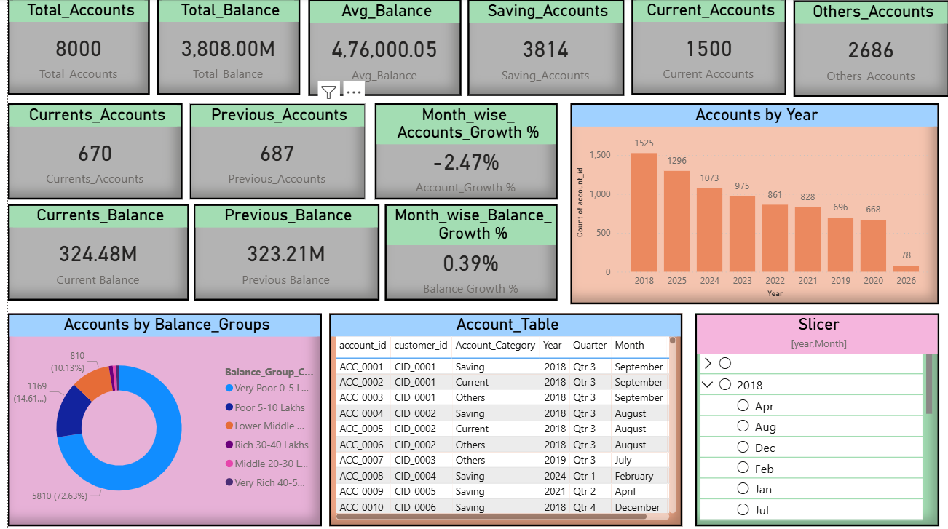
Accounts Analysis Dashboard

Slide 14
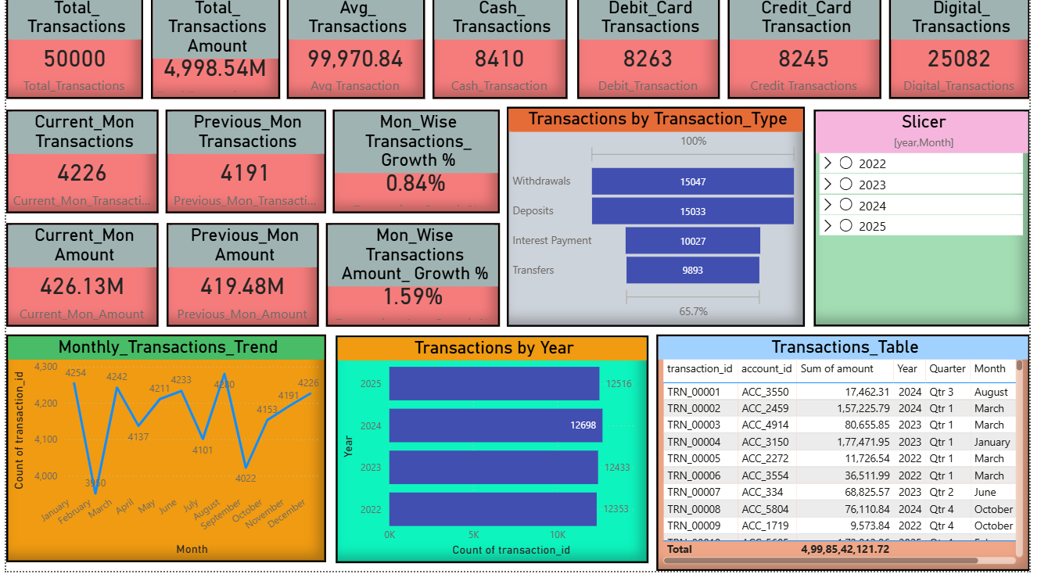
Transaction Analysis Dashboard
Insert Screenshot Here

Slide 15
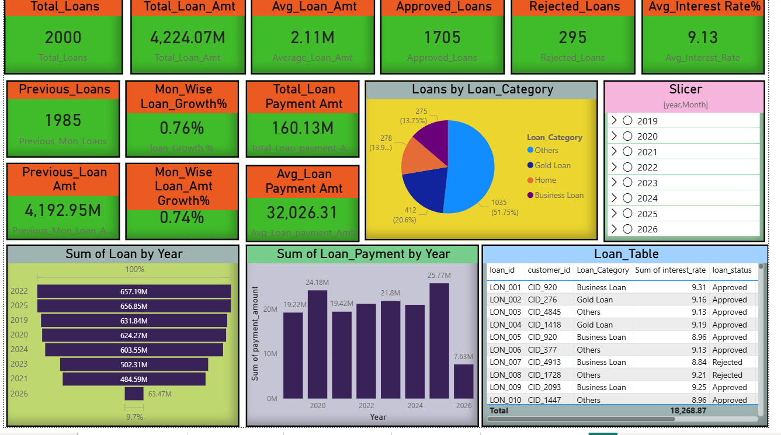
Loan & Loan Payment Dashboard
Insert Screenshot Here

Slide 16
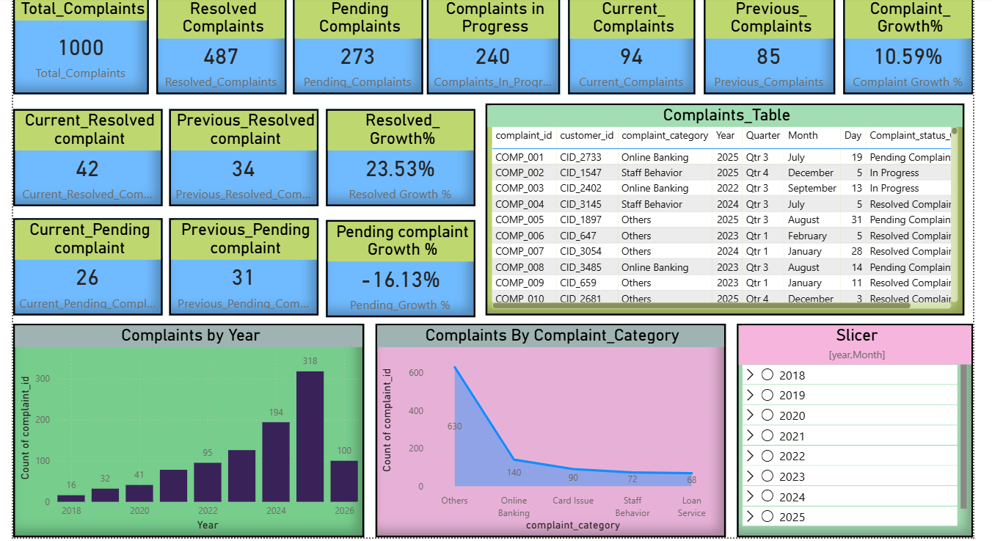
Complaints Dashboard
Insert Screenshot Here

Slide 17
Key Insights
• Identified high-value customers based on transactions
• Analyzed loan distribution and repayment trends
• Observed transaction growth and payment modes
• Monitored complaint trends and resolution status
• Improved understanding of customer behavior

Slide 18
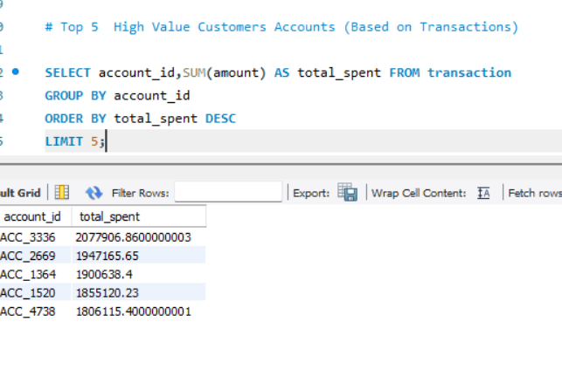
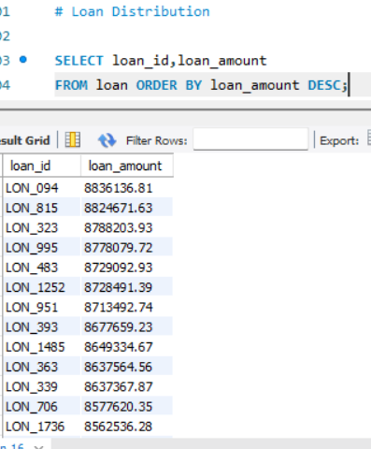
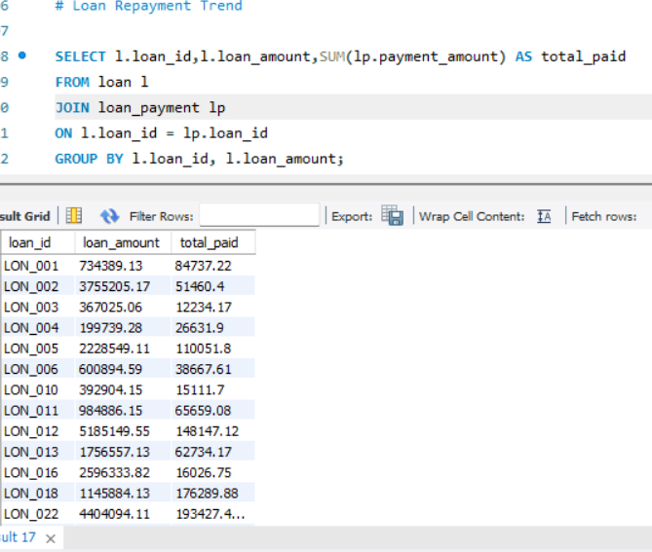
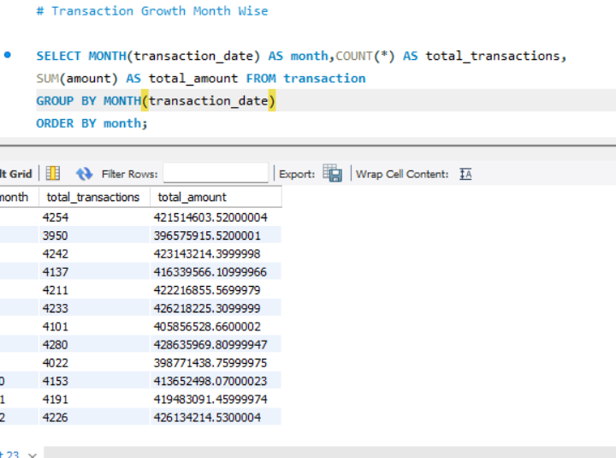
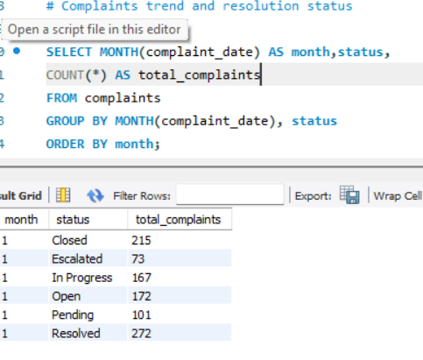
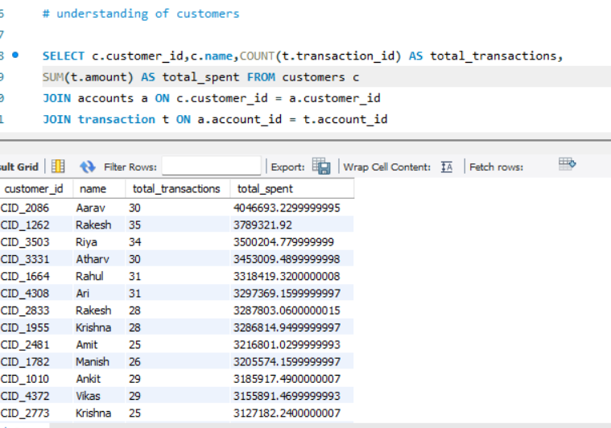

Slide 19
Future Work / Scope
• Customer segmentation using RFM
• Predictive analysis for loan default
• Automation using Python pipelines
• Real-time dashboard integration

Slide 20
References
• Synthetic Banking Dataset
• Python (Pandas, NumPy)
• SQL Documentation
• Power BI Documentation

Slide 21
Thank You

